Slide 1
Movie Poster Examples!
See if you can find all the elements for your poster

Slide 2
“While Death watches…” is the tag-line. Look for this in the other posters as well. Make it catchy, mysterious, or funny to interest your classmates!

Slide 3
Your poster doesn’t need to be action packed.
Sometimes, less is better!
Just put something on it to represent the main conflict or theme of your book.

Slide 4
In order to show setting on your poster, you can put a famous landmark in it, like this one does with the Empire State Building.
Or, you could add it into your title. You need to come up with a new title for your book (see the last bullet point on your Movie Outline page), and it could include something about the place it’s set. For example:
“Percy Jackson & the Demi-Gods of New York”
Or something like that.

Slide 5
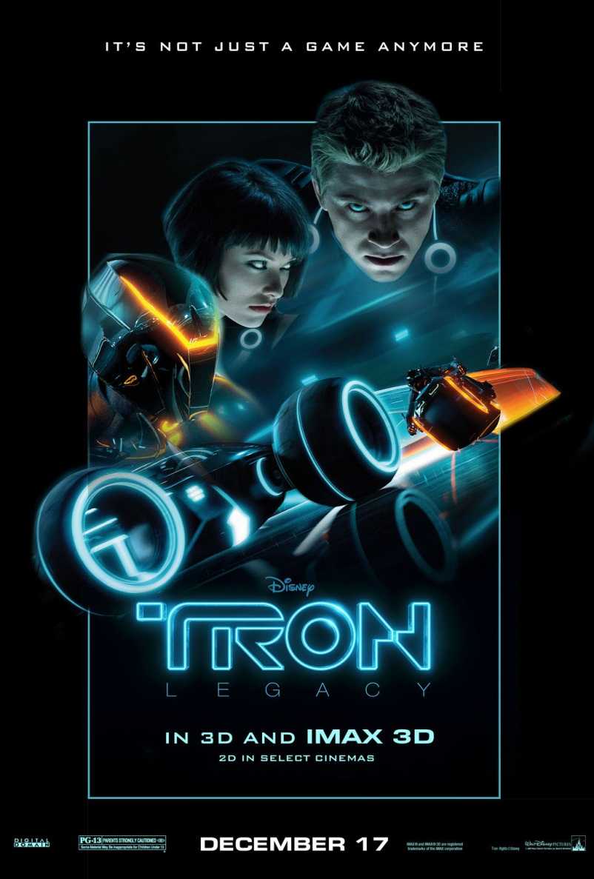
More examples
Some posters are more interesting than others because of the tagline or the images.

Slide 8
Your main characters names need to be on the poster, as though they were the actors.

